Slide 1
DETER: Deterministic TCP Replay for Performance Diagnosis
Yuliang Li, Rui Miao, Mohammad Alizadeh, Minlan Yu

Slide 2
TCP performance diagnosis is important
Apps are more distributed
Increasingly rely on the TCP performance
Tail latency is impactful
A single long latency slows down the entire task
Need a diagnosis tool for TCP problems in large scale production networks

Slide 3
Why diagnosing TCP is hard?
What I learned in the textbook
Slow start
Cong. Avoid.
Send ACK
Fast recovery
Receiver
Sender

Slide 4
TCP is complex!
Reality…
TSO
Nagle test
Recv buffer manager
Socket call manager
Packet
generator
Packet processor
Recv window manager
Pacing rate manager
Congestion control
Congestion control
Socket call manager
Loss recovery
ACK processor
ACK generator
Delayed ACK manager
Timer manager
Receiver
Send buffer manager
Receiver
Attack mitigation
Sender
Send window manager
Sender

Slide 5
TCP is complex!
Unexpected interactions between diff components
TSO
Nagle test
Recv buffer manager
No fast recovery
Recv window manager
Socket call manager
Packet
generator
Packet processor
Recv window manager
Pacing rate manager
Congestion control
Congestion control
Socket call manager
Loss recovery
ACK generator
Loss recovery
ACK processor
Delayed ACK manager
Timer manager
Receiver
Send buffer manager
Receiver
Attack mitigation
Sender
Send window manager
Sender

Slide 6
TCP is complex!
Unexpected interactions between diff components
TSO
Nagle test
Recv buffer manager
Socket call manager
Packet
generator
Packet processor
Recv window manager
Pacing rate manager
Congestion control
Congestion control
Socket call manager
Loss recovery
ACK processor
ACK generator
No response
Delayed ACK manager
Timer manager
Receiver
Receiver
Attack mitigation
Send buffer manager
Attack mitigation
Sender
Send window manager
Sender
Ignore the packet
Send window manager

Slide 7
TCP is complex!
Unexpected interactions between diff components
63 parameters in Linux TCP that tune the behaviors of diff components
Continuous error-prone development:
16 bugs found in July & Aug of 2018 in Linux TCP
TSO
Nagle test
Recv buffer manager
Socket call manager
Packet
generator
Packet processor
Recv window manager
Pacing rate manager
Congestion control
Congestion control
Socket call manager
Loss recovery
ACK processor
ACK generator
Delayed ACK manager
Timer manager
Send buffer manager
Receiver
Attack mitigation
Send window manager
Sender

Slide 8
How do we diagnose TCP today?
Tcpdump

Slide 9
Detailed diagnosis is not scalable
Bandwidth
# hosts
100Gbps
100,000s
10,000x
10,000x
10Mbps
10s
1990
2000
2010
2019
Tcpdump
Tcpdump
Tcpdump
Tcpdump
Too much overhead!

Slide 10
Tension between more details and low overhead
Runtime record = Data for diagnosis
Existing tools cannot achieve both
DETER solves it, by introducing replay
Lightweight recording during the runtime
Replay every detail
Runtime record < Data for diagnosis
Overhead
Lots of details,
but high overhead
Tcp probe
Tcpdump
ebpf
DETER
All details,
low overhead
Low overhead,
but miss lots of details
Tcp counters
Details for diagnosis

Slide 11
DETER overview
10.0.0.1:80->20.0.0.1:1234
has long latency
Runtime
Replay
Tcpdump
× N
TCP Probe
DETER Recorder
10.0.0.1:80 -> 20.0.0.1:1234
DETER Replayer
20.0.0.1:1234 -> 10.0.0.1:80
Lightweight record
Run continuously
On all hosts
Deterministic replay
Capture packets/counters
Trace executions
Iterative diagnosis

Slide 12
Lightweight record
Deterministic replay

Slide 13
Intuition for being lightweight
Deterministic replay
Lightweight record
FAIL!
Record socket calls
Automatically generate packets
sockcall
TCP
TCP
sockcall

Slide 14
Non-deterministic interactions w/ many parties
sockcall
TCP
TCP
sockcall

Slide 15
Non-deterministic interactions w/ many parties
Key contribution:
Identifying the minimum set of data that enables deterministic replay
Two challenges:
Network wide: non-deterministic interactions across switches and TCP
On host: non-determinisms within the kernel
sockcall
kernel
kernel
sockcall
TCP
TCP
Butterfly effect
sockcall
kernel
kernel
sockcall
TCP
TCP
sockcall
kernel
kernel
sockcall
TCP
TCP

Slide 16
Challenge 1: butterfly effect
The closed loop between TCP and switches amplifies small noises
sockcall
kernel
kernel
sockcall
TCP
TCP
TCP
TCP
sockcall
kernel
kernel
sockcall
TCP
TCP
TCP
TCP
sockcall
kernel
kernel
sockcall
TCP
TCP
TCP
TCP
16

Slide 17
Challenge 1: butterfly effect
Sending time variation
Switch action variation
μs-level:
Clock drift, context switching, kernel scheduling, cache state
TCP behavior variation
Runtime
Replay
Cong_win/=2
Cong_win++
sockcall
TCP
drop
sockcall
TCP
enqueue
sockcall
TCP
enqueue
sockcall
TCP
drop
Cong_win++
Cong_win/=2
1 us late

Slide 18
Challenge 1: butterfly effect
Sending time variation
Switch action variation
Butterfly effect
TCP behavior variation
Runtime
Replay
Cong_win/=2
Cong_win++
sockcall
TCP
sockcall
TCP
sockcall
TCP
sockcall
TCP
Cong_win++
Cong_win/=2
drop
enqueue
sockcall
TCP
sockcall
TCP

Slide 19
Challenge 1: butterfly effect
To understand the impact of butterfly effect
We try to replay a long latency problem in a 3-host testbed with 3 flows, by issuing the same set of socket calls as runtime
Replay 100 times, but none of them reproduce the same problem.
Sending time variation
Switch action variation
Butterfly effect
What if we reduce it?
TCP behavior variation

Slide 20
Challenge 1: butterfly effect
Run the same experiment in simulation, while controlling the sending time variation, from 0 to 1000ns
Sending time variation
Switch action variation
Butterfly effect
What if we reduce it?
TCP behavior variation
Reducing sending time variation
cannot eliminate butterfly effect
Even 1ns variation still cause butterfly effect

Slide 21
Challenge 1: butterfly effect
Sending time variation
Switch action variation
Butterfly effect
Butterfly effect
TCP behavior variation
sockcall
TCP
TCP
sockcall
sockcall
TCP
TCP
sockcall
sockcall
TCP
TCP
sockcall
Record&replay
Record&replay

Slide 22
Challenge 1: butterfly effect
High overhead
Directly borrow classic kernel replay techniques?
sockcall
TCP
TCP
sockcall
sockcall
TCP
TCP
sockcall
sockcall
TCP
TCP
sockcall
Record&replay
Record&replay

Slide 23
Challenge 1: butterfly effect
Directly borrow classic kernel replay techniques?
Solution: record&replay packet stream mutations
Runtime
sockcall
TCP
TCP
sockcall
sockcall
TCP
TCP
sockcall
sockcall
TCP
TCP
sockcall
Drop
Mark ECN
Packet stream mutations
Replay
Reordering
sockcall
TCP
TCP
sockcall
sockcall
TCP
TCP
sockcall
sockcall
TCP
TCP
sockcall

Slide 24
Challenge 1: butterfly effect
Directly borrow classic kernel replay techniques?
Solution: record&replay packet stream mutations
Runtime
sockcall
TCP
TCP
sockcall
sockcall
TCP
Record
mutations
TCP
sockcall
sockcall
TCP
TCP
sockcall
Record
mutations
Drops, ECN, reordering, etc.
Drops, ECN, reordering, etc.
Replay
sockcall
TCP
TCP
sockcall
sockcall
TCP
Replay
mutations
TCP
sockcall
sockcall
TCP
TCP
sockcall
Replay
mutations

Slide 25
Challenge 1: butterfly effect
Solution: record&replay packet stream mutations
+ Low overhead:
Drop rate < 10⁻⁴;
ECN: 1 bit/packet;
Reordering is rare
Runtime
sockcall
TCP
TCP
sockcall
sockcall
TCP
Record
mutations
TCP
sockcall
+ Replaying each TCP connection is independent
Connections interact via drops and ECN, which we replay.
sockcall
TCP
TCP
sockcall
Record
mutations
Resource-efficient replay:
- Just need two hosts
+ Need no switches for replay
Drops, ECN, reordering, etc.
Drops, ECN, reordering, etc.
Replay
sockcall
TCP
TCP
sockcall
sockcall
TCP
Replay
mutations
TCP
sockcall
sockcall
TCP
TCP
sockcall
Replay
mutations

Slide 26
Challenge 1: butterfly effect
Solution: record&replay packet stream mutations
Runtime
Only record on hosts
sockcall
TCP
Record
mutations
TCP
sockcall
Record
mutations
Drop
1
2
3
4
5
Drop:
4
IP_ID is consecutive
Replay
sockcall
TCP
Replay
mutations
TCP
sockcall
Replay
mutations
1
2
3
4
5
Drop

Slide 27
Challenge 2: non-determinisms within the kernel
kernel
kernel
sockcall
TCP
Replay
mutations
TCP
sockcall
Replay
mutations

Slide 28
Handling non-determinisms within the kernel
Very few
Other handler function calls (e.g., OS timer calls timeout handler)
Thread scheduling
Order of lock acquisitions of diff threads
Reading kernel variables (e.g., jiffies)
10s of consecutive locks by the same thread, compress a lot
Normally race conditions are expensive to record and replay
But TCP uses one lock per connection to prevent race conditions
So we record & replay the order of lock acquisitions of diff threads
Value changes infrequently, only record new values
Correct input to TCP
Runtime
Replay
kernel
kernel
TCP
Record
mutations
TCP
Replay
mutations
sockcall
Sockcall hdl
Pkt hdl
sockcall
Sockcall hdl
Pkt hdl
Timeout hdl
DETER
lock
Timeout hdl
DETER
lock
lock
timer
Read_jiffies
Hdl caller
Read_jiffies
jiffies

Slide 29
Getting packet timestamp
Replay gets correct sequence of events & packets (i.e., logical time)
But packet timestamps may be inaccurate.
Runtime
Send p1
Send p2
Recv a1
Cwnd++
RTO
Cwnd/=2
Send p3
Send p1
Replay
Cwnd++
RTO
Send p1
Send p2
Send p3
Recv a1
Cwnd/=2
Send p1

Slide 30
Getting packet timestamp
Record packet timestamps and fill them in the trace
Use sampling to reduce the overhead of per-packet timestamp
Record sampled timestamps
Infer the rest with bounded error
Replay
Time | Packet
 | p1
 | p2
 | p3
 | p4
 | p5
 | …
 | pn
t1
record
?
t2
?
infer
t3
?
t4
record
?
t5
?
infer
…
?
tn
?

Slide 31
Getting packet timestamps
Gap-based sampling?
time
Large diff
Packet #

Slide 32
Getting packet timestamps
Gap-based sampling?
Rate-based sampling!
Bound the inference error with a threshold th
time
> th
Packet #

Slide 33
Implementation
Prototype in Linux 4.4
Lightweight recorder (packet stream mutations, 3 types of kernel non-determinism)
Storage: 2.1%~3.1% compared to compressed packet header traces.
CPU: < 1.49%
All data are recorded on end hosts.
Just need 139 lines of changes to Linux TCP.
Open source

Slide 34
An RTO problem in testbed
Two senders to one receiver
2 long flows (20MB) and 1 short flow (30KB)
The short flow experiences 49 ms delay (2 orders of magnitude higher than expected)
In contrast, retransmission timeout (RTO) is 16ms
TCP counters are not enough: they shows 2 RTO, but 2*16 < 49.

Slide 35
An RTO problem in testbed
Diagnosis Info:
2 RTO
Exponential backoff
5
4
Why the receiver doesn’t ACK?
3
32ms
3
16ms
5
4
3
2
1
Sender
Receiver

Slide 36
An RTO problem in testbed
Diagnosis Info:
2 RTO
Exponential backoff
Delayed ACK
Counter
TCP expert may guess
5
4
Monitor function call graph (Ftrace)
DETER+Tcpdump
DETER+Ftrace
3
Enters delayed ACK function
3
5
4
3
2
1
Sender
Receiver

Slide 37
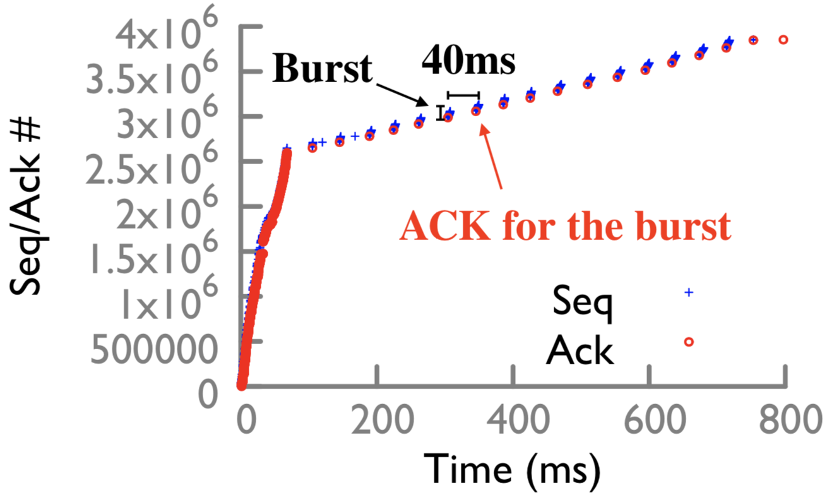
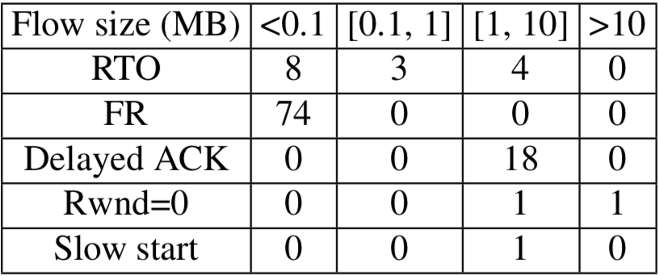
Case study in Spark
Terasort 200 GB on 20 servers (4 cores each) on EC2, 6.2K connections
Replay and collect trace for problematic flows
The receiver explicitly delays the ACK, because the recv buffer is shrinking
Caused by the slow receiver

Slide 38
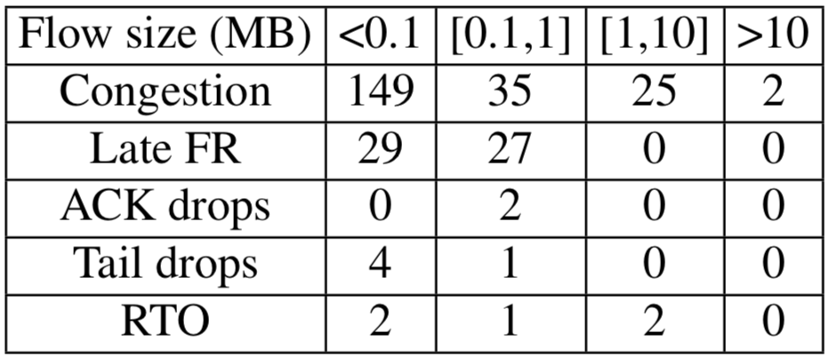
Case study in RPC
An RPC application running empirical DC traffic on 20 servers (4 cores each) on EC2, 280K requests
Late Fast Retransmission: fast retransmit after 10s of dupACKs.
The threshold for dupACK increases, from 3 to 45.
Due to reordering in the past

Slide 39
Other use cases
We can diagnose many other problems in the TCP stack
RTO caused by diff reasons: small messages, misconfiguration of recv buf size
We can also diagnose problems in the switches
Because we have traces, we can push packets into the network
In simulation (requires modeling switch data plane accurately)
Case study: A temporary blackhole caused by switch buffer sharing

Slide 40
Conclusion
DETER enables deterministic TCP replay
Lightweight: always on during runtime
Detailed diagnosis during the replay
Key challenge: butterfly effect
Record & replay packet stream mutations to break the closed loop between TCP and switches.
https://github.com/harvard-cns/deter

